Slide 1



Natural language processing to capture person-first or identity-first language
Notes:
I wondered about giving ESHG some credit, but not sure

Slide 2
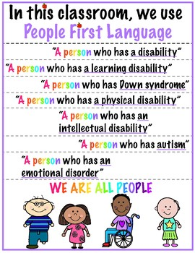
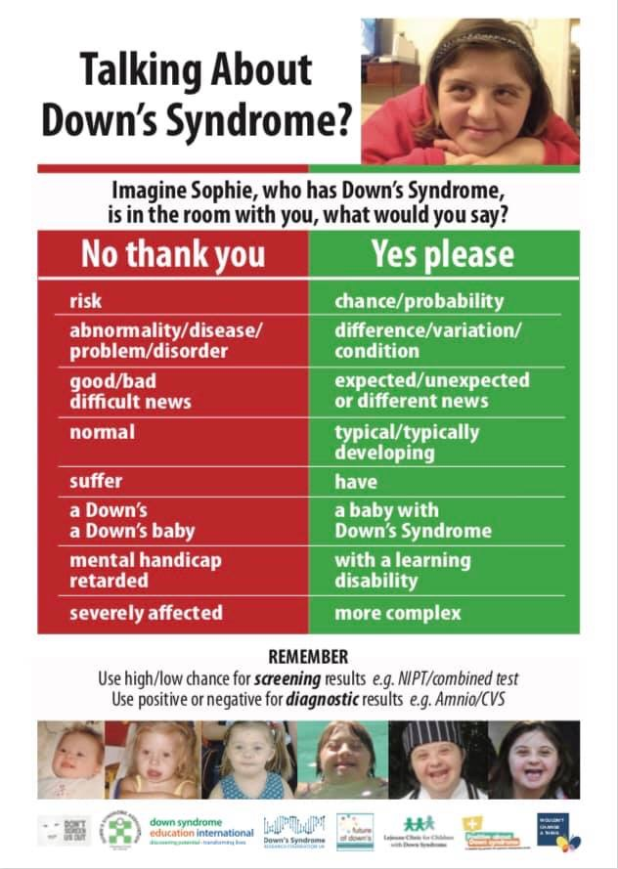
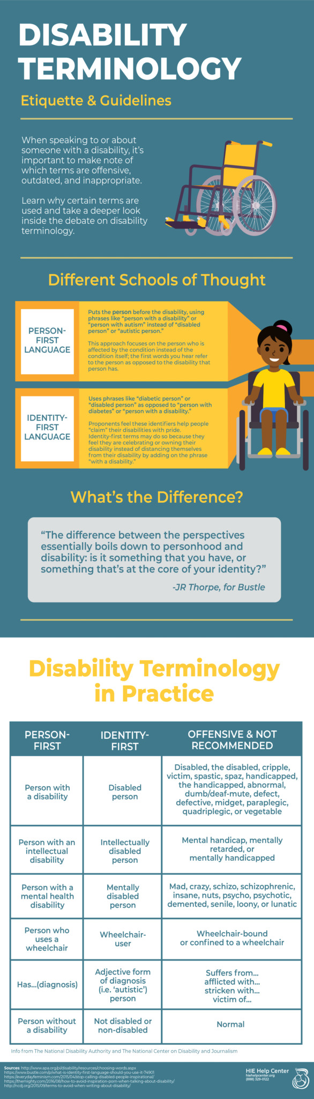
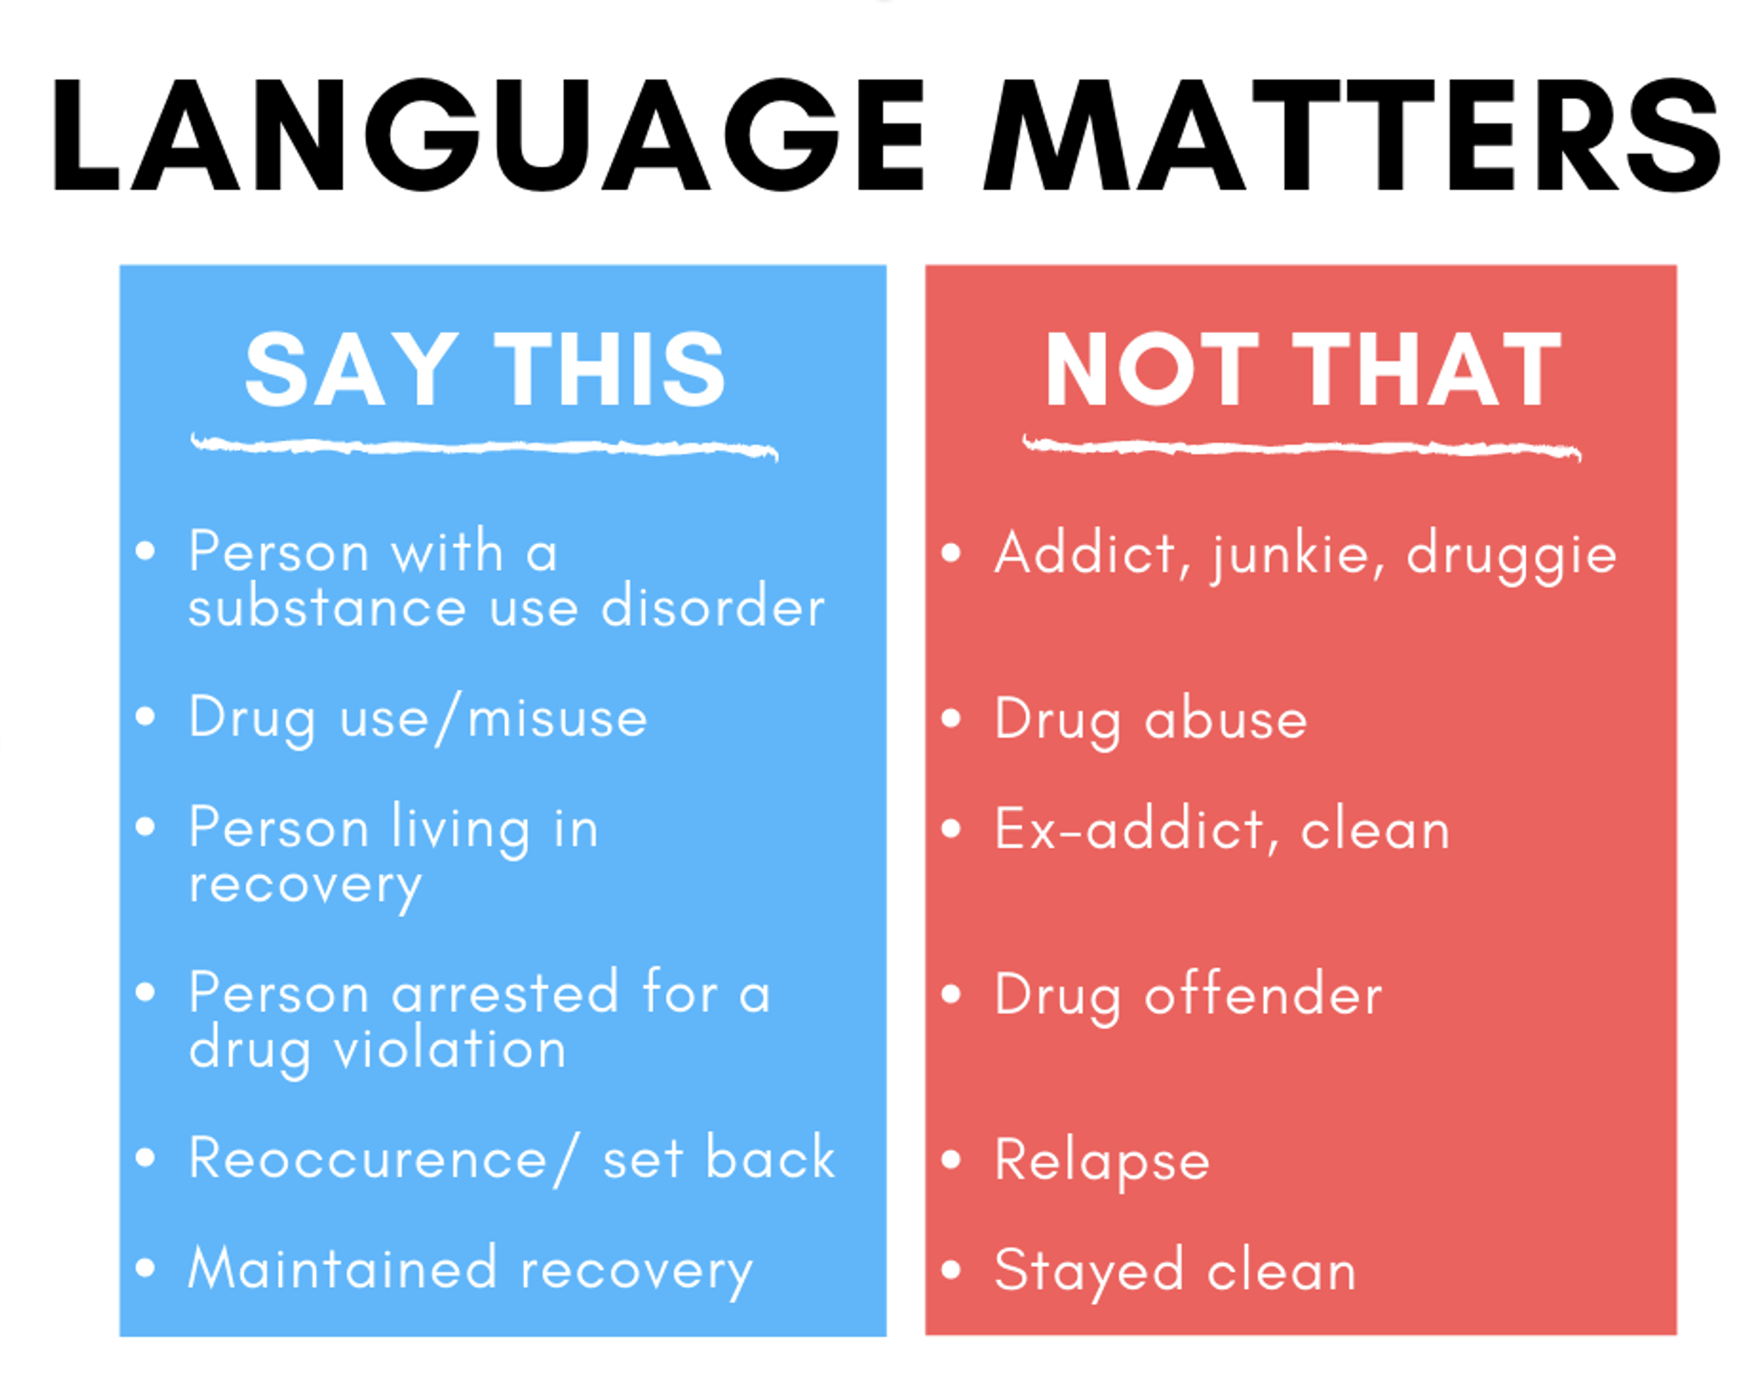
Notes:
You mat not want this, and this may not be needed as the 3rd speaker is a clinician and will bring the clinical/families perspective in

Slide 3
How much do you know about NLP methods?

Slide 4

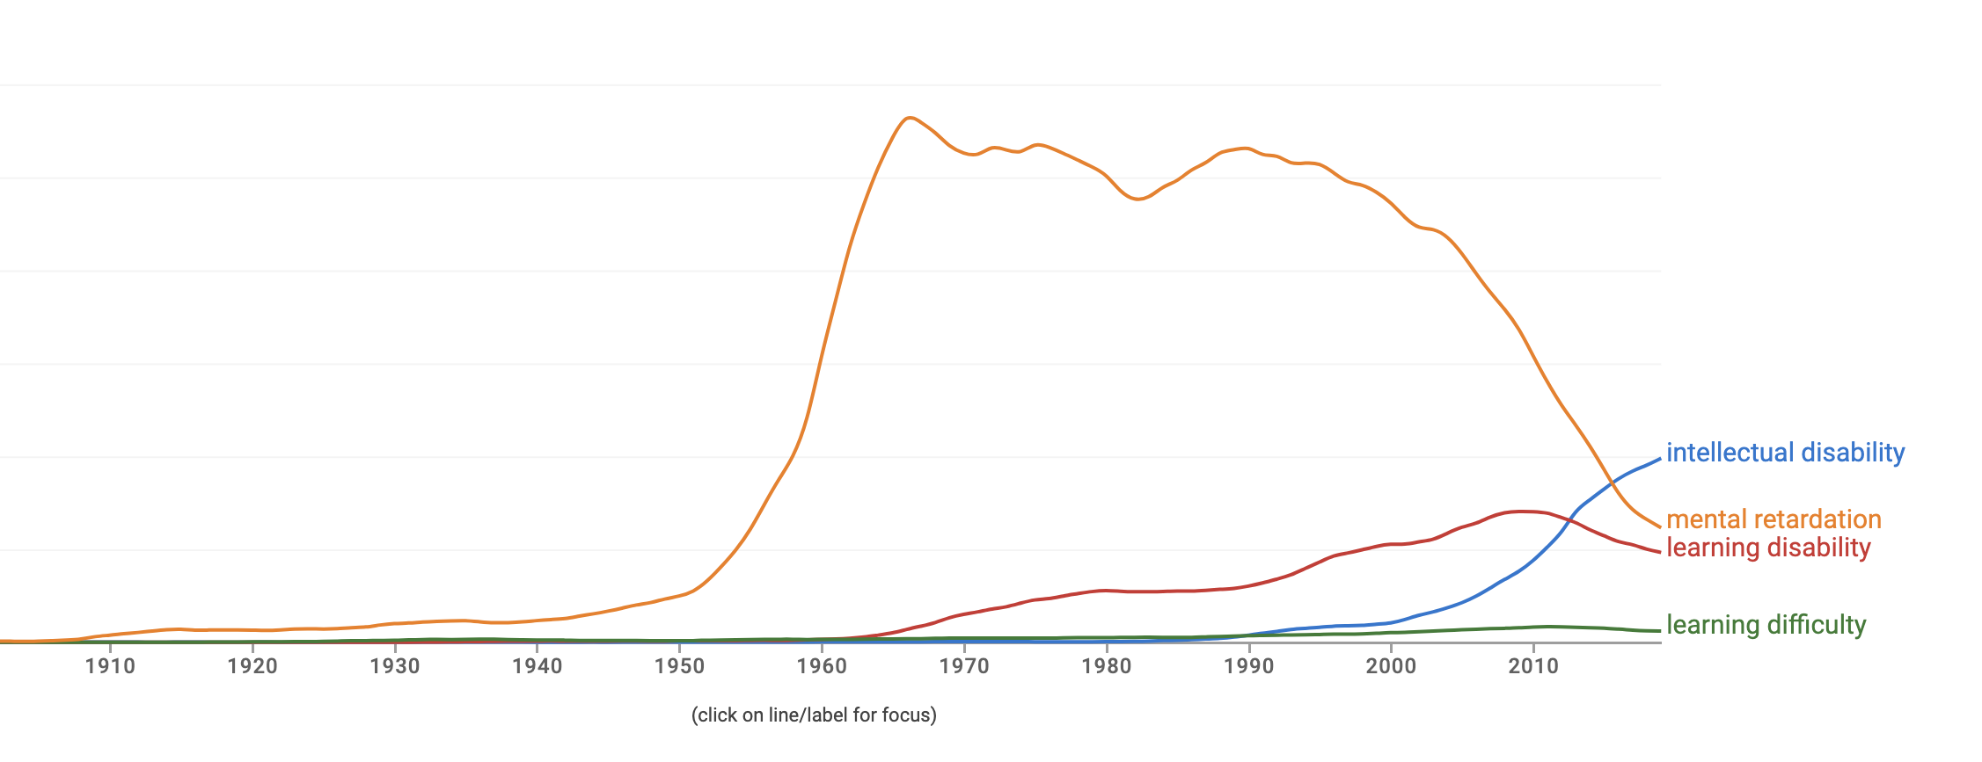
Notes:
Again, not sure if you think this is helpful, only if you want to highligh how languages changes over time

Slide 5
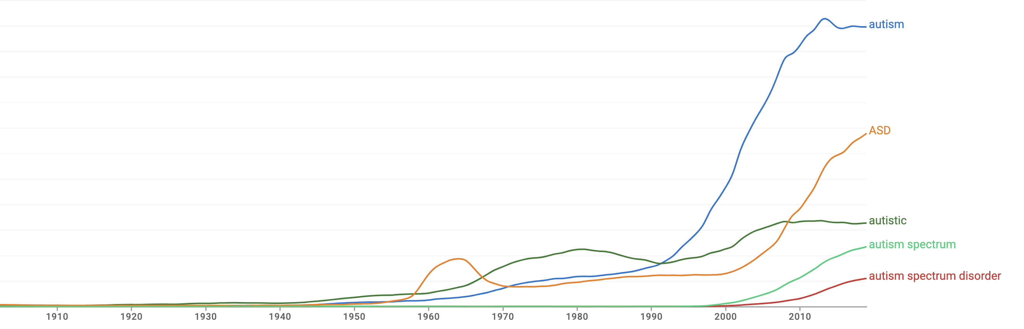

Slide 6
Euphemism treadmill
Process by which euphemisms become negative, pejorative, or taboo

Slide 7
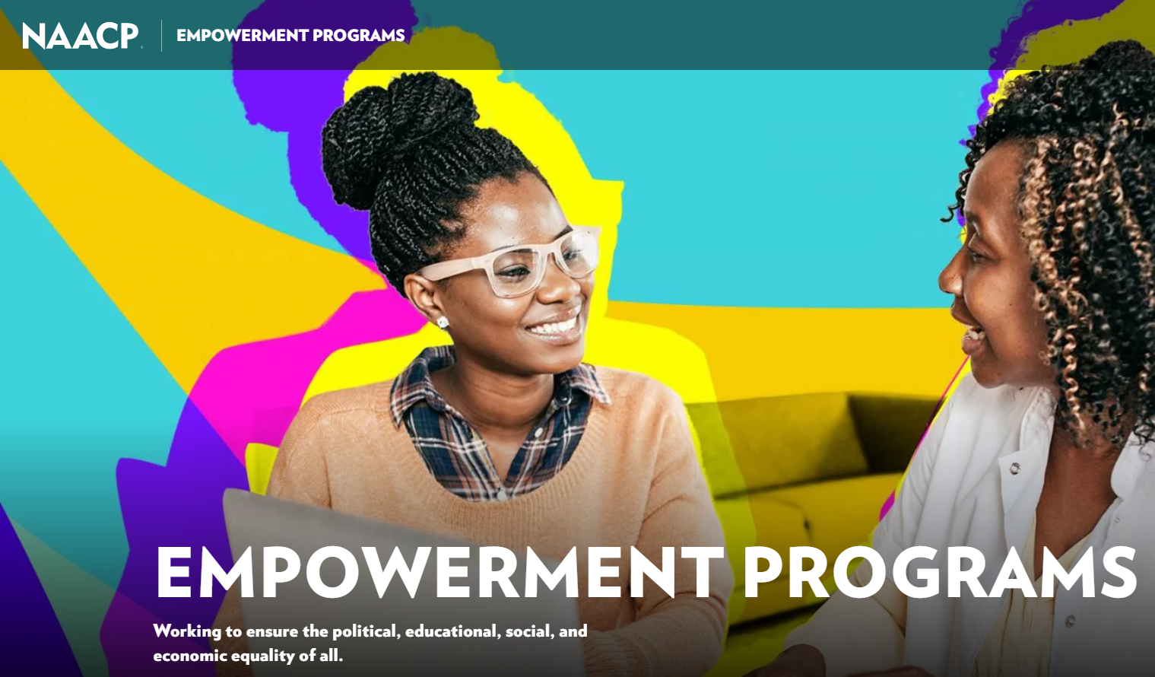
Euphemism treadmill example

Slide 8
Reclaiming euphemisms?
Sometimes people prefer the “offensive” terms
țigan / tzigane
More negative connotations than “roma” but used by some members to refer to themselves without offence
queer
Originally meaning “strange” or “peculiar”, then used as a pejorative, later reclaimed as a deliberatively provocative term

Slide 9
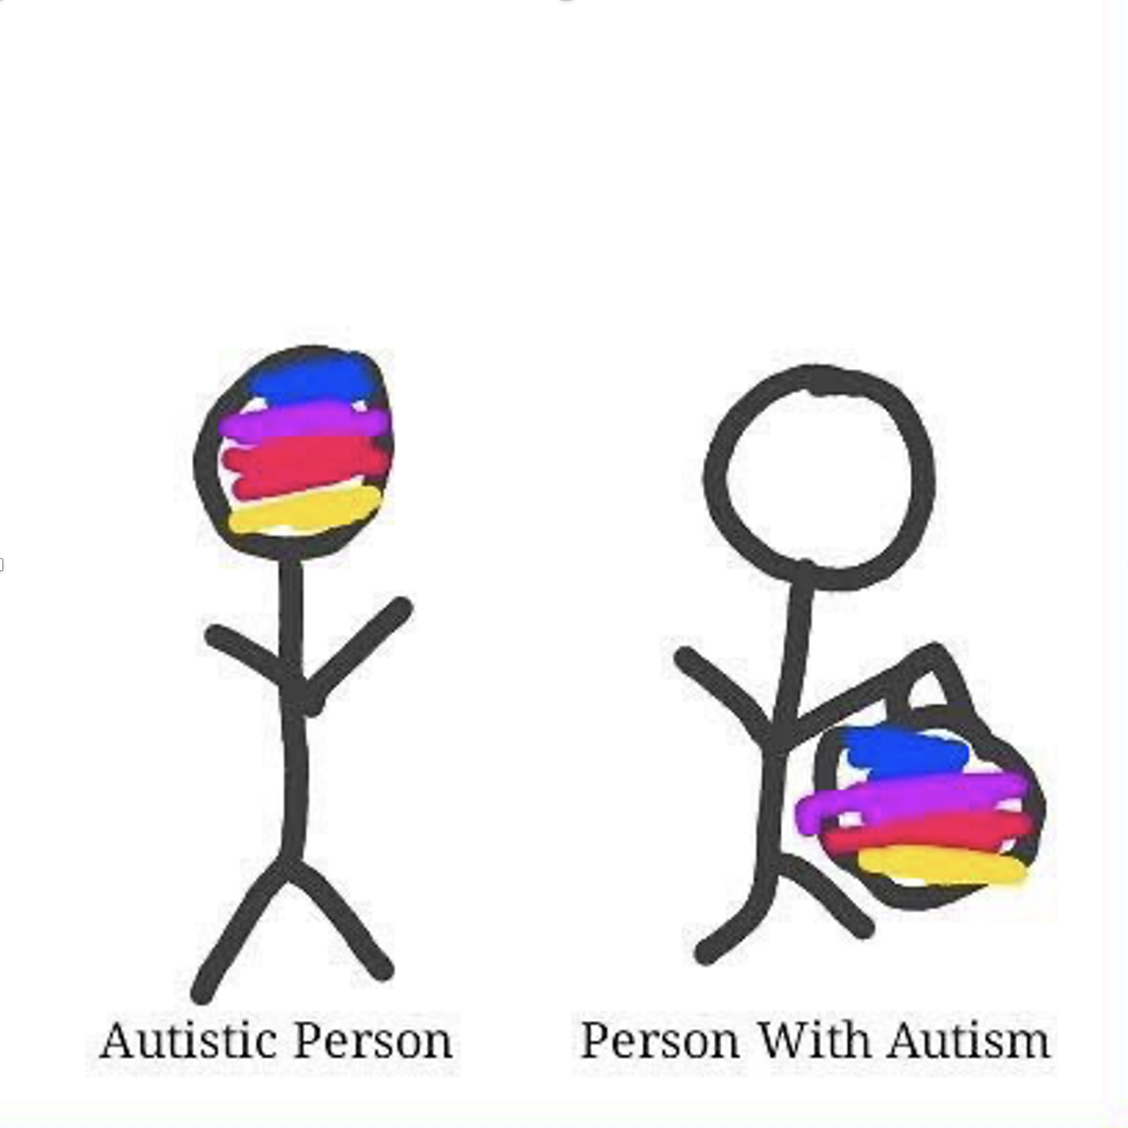
Person-first language
Person-first – “person with autism”, “child with hearing difficulties”, etc.
intends to highlight personhood before diagnosis
meant to avoid dehumanisation, marginalisation, or essentialisation
describes what a person “has” rather than what a person “is”
Notes:
Clearly, there is a problem with 2004.

Slide 10
Identity-first language
Identity-first - “an autistic person”, “a Deaf child”, etc.
some people see these terms as part of their identity/community
doesn’t separate person from adjective or suggest people are “same” with …
social model of disability suggests people “are” disabled by society
Notes:
Clearly, there is a problem with 2004.

Slide 11
Do you typically use person or identity first language?

Slide 12
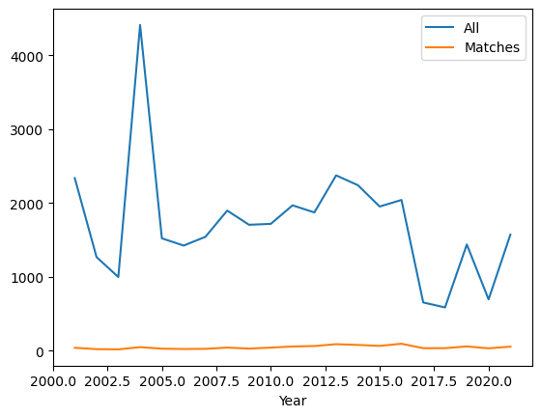
Data = ESHG abstracts
173,955 abstracts in total
1721 with the keywords “autism”, “autistic”, “ASD” or “asperger”
Notes:
Clearly, there is a problem with 2004.

Slide 13
Preparation
31 .pdf files
Acquire original files
Convert .pdf to .txt
All text from .pdf into one line
NLP
Frequency counts
Remove irrelevant pages (cover page, adverts, index, etc.)
Split line by abstract marker
Subset abstracts with keywords 173,995 abstracts -> 1721 abstracts
Examine contexts
Notes:
31 .pdf (some years have 2 files, e.g. one for presentation abstracts and one for poster abstracts)
Semi-manual process to remove irrelevant pages (e.g. remove the indices, cover pages, etc.)
Convert .pdf to .txt files
Split .txt file into abstracts by delimiters 167336
Find all abstracts that contain keywords 1694

Slide 14
NLP Frequency Counts - “bag of words”
Prep
Tokenise words
Lowercase
Remove punctuation
Remove whitespaces
Remove stop words
Consolidate
* Correct spelling
* Substitute synonyms
Stem words
Analyse
Count word frequency
* Not used in the preliminary process

Slide 15
Stemming
A simplistic method of reducing words to a basic form
Collapses nouns and verbs together, as well as singular/plural, first/second/third person, future/present/past tenses, etc.
Examples:
Dog, dogs, and dogged would all reduce to “dog”
Went, going, goes and go would all reduce to “go”

Slide 16
Most common words in abstracts
All abstracts | 'gene' | 'patient' | 'mutat' | 'genet' | 'studi' | 'use' | 'case' | 'result' | 'analysi' | 'associ'
Count | 69245 | 60113 | 57719 | 42684 | 32414 | 28317 | 27007 | 25783 | 24804 | 24741
Matched abstracts | 'patient | 'gene' | 'genet' | 'disord' | 'autism' | 'syndrom' | 'delet' | 'mutat' | 'case' | 'clinic'
Count | 2081 | 1921 | 1235 | 1088 | 1088 | 1087 | 1068 | 984 | 953 | 902

Slide 17
NLP Examine Context - “pattern extraction”
Prep
Tokenise sentences
* Lowercase
* Remove punctuation
* Remove whitespaces
Consolidate
* Correct spelling
* Substitute synonyms
Isolate relevant sentences
Analyse
Extract person-first and identity-first patterns
Count each pattern
Examine each pattern
POS-tag
* Not used in the preliminary process
Notes:
153653 relevant sentences

Slide 18
“Noun with” / person-first pattern
pattern = [{"POS": "NOUN"},
{“LOWER": “with"}
{'DEP':'amod', 'OP':"?"},
{'DEP':'amod', 'OP':"?"},
{'DEP':'amod', 'OP':"?"},
{"TEXT": {"REGEX": “[Au]utism“ or “[Aa]sperger” or “ASD”}}]
Notes:
Identified in this data set include boy with ASD and individual with idiopathic autism,

Slide 19
“Adjective noun” / identity-first pattern
pattern = [{"TEXT": {"REGEX": “[Au]utistic“ or “[Aa]sperger” or “ASD”}},
{'DEP':'amod', 'OP':"?"},
{'DEP':'amod', 'OP':"?"},
{'DEP':'amod', 'OP':"?"},
{"POS": "NOUN"}]
Notes:
Examples from this dataset include: ASD affected sibling and autistic female

Slide 20
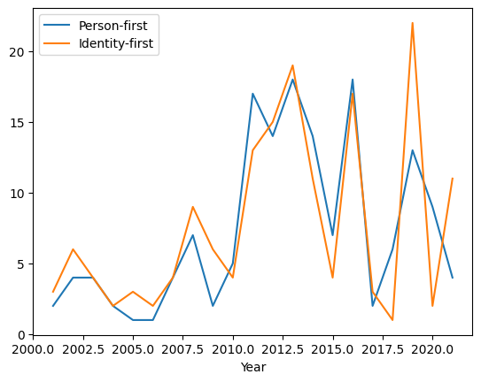
Person-first and Identity-first counts by year

Slide 21
Most common examples of both patterns

Slide 22
Total counts of patterns and count of abstracts that use one, other or both

Slide 23
Why might factor into it?
Do we see differences based on:
- native language
- age of person described
- year
- use of adjectives in non-people related contexts
- other?
Notes:
Clearly, there is a problem with 2004.

Slide 24
Feel free to ask us questions!

Slide 25
Who we are:
Professor Ramona Moldovan
University of Manchester, UK
Babeș-Bolyai University, Romania
Ramona.Moldovan@mft.nhs.uk
Dr. J. Kasmire
Cathie Marsh Institute University of Manchester, UK
UK Data Service
J.Kasmire@manchester.ac.uk
@JKasmireComplex
Andrada Ciucă
Babeș-Bolyai University, Romania
andradaciuca@psychology.ro
Notes:
Clearly, there is a problem with 2004.

